Slide 1
Sprint 8 Summary
Piazza

Slide 2
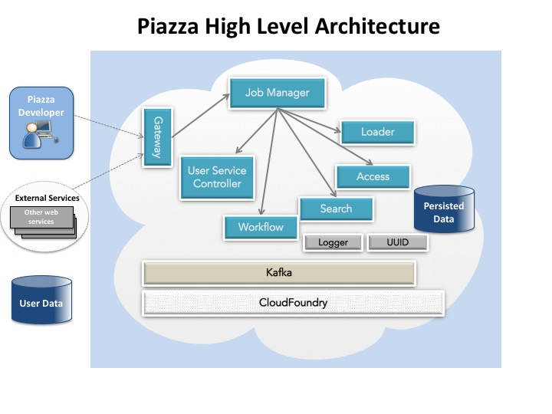
Accomplishments
Gateway/API
Security
Service Controller
Search
DevOps
Testing
OGC APIs (GeoServer)

Slide 3
SAK UI
High-level of what got done this sprint:
Refactored calls to the pz-gateway to use the latest api
Added framework for unit testing SAK

Slide 4
Piazza Testing
Created Boundary Condition Tests to check for error status response (Added to Jenkins)
Created script to send email alert when automated testing fails
Updated automated tests to cover all Gateway calls except for workflow
Updated Test Plan. Includes:
Severity levels
Testing methodology for Piazza unit tests, integration tests, and regression testing.

Slide 5
UI Testing
Started testing SAK UI

Slide 6
Pz-security
Updated /verification endpoint to authenticate users against the Geoint Services LDAP
Added CORS headers to the authentication responses for BeachFront integration
Added custom 'citester' account for authentication, BeachFront integration
Deployed all of the above changes to the int space

Slide 7
Other Pz-Core components
pz-gateway
Refactored out Dispatcher to enhance efficiency
Added support for delete of data resources
pz-servicecontroller
Added support for raw Geojson
Fixed Defect – Raw JSON
Support for user service deletion
pz-search
User service metadata
Refactoring - Rewrote code to conform to Java API
Upgraded to latest (2.x) ES

Slide 8
Documentation
Users Guide (Tutorial)
Some sections updated with examples for various components
Developers Guide
Some sections updated

Slide 9
Preparation, Delivery and Deployment (ATO)
Description
Recent Accomplishments
This task involves preparing, delivering and deploying VeniceGeo systems into the operational low-side and high-side environments. It involves:
Determining the requirements that need to be met
Communicating how the systems plan to be used within the targeted environments
Remediating any identified items to ensure systems meet security/operational integrity requirements
Systems targeted for ATO:
Piazza
Beachfront
Identified a list of items to produce for each system:
System Security Plan (SSP)
Concept of Operations (CONOPS)
Software Dependency List
System/Software architecture diagrams to support Cloud Adoption work product, SSP and CONOPS
VeniceGeo Security POC - Steven Ross
Obtained SSP, CONOPS templates
Issues/Risk
Next Steps
To continue to collaborate with NGA Security POCs to clarify and finalize requirements
To work on producing SSP and CONOPS
To develop list of software dependencies to reconcile against whitelist/SWAP List
To work on identifying additional software quality requirements
Unit test code coverage metrics
To start work to integrate with quality/security analyzers within geointservices DevOps Pipeline
HPFortify
Sonarqube
None at this time.

